Slide 1
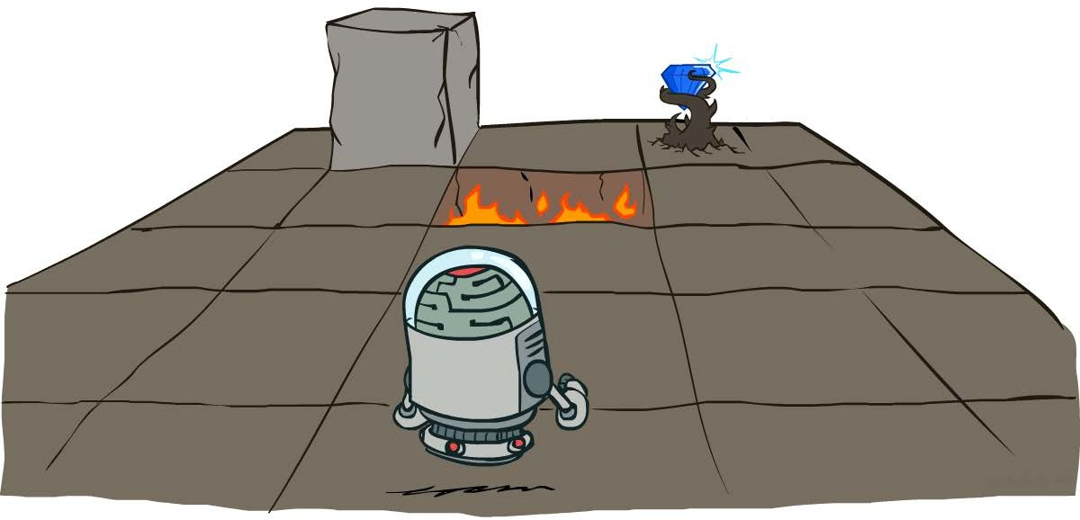
Math-810: MMAI
Markov Decision Processes
Instructor: Dr. Soyiba Jawed
National University of Sciences & Technology
(slides adapted from Dan Klein, Pieter Abbeel, Anca Dragan, et al.)

Slide 2
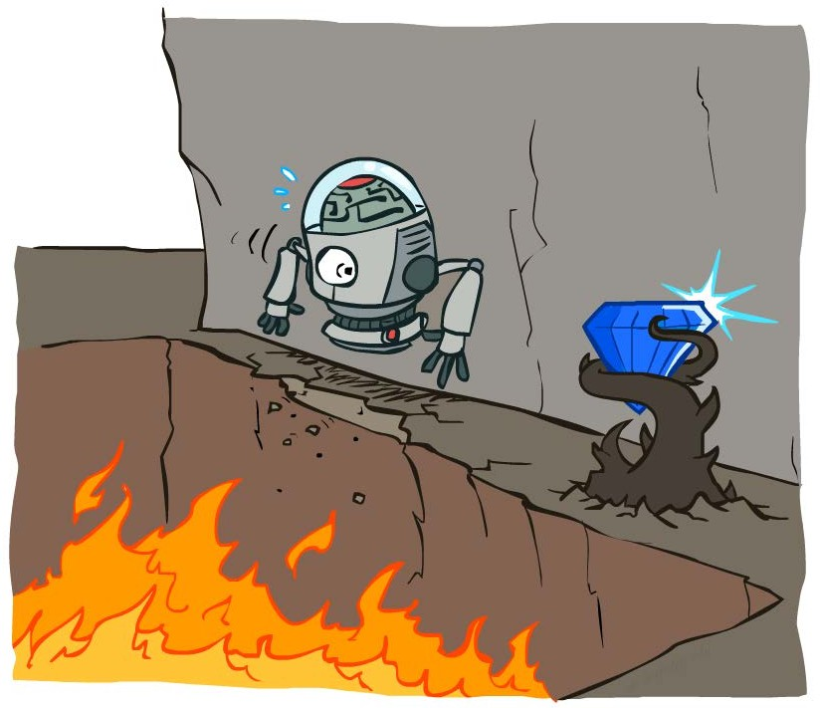
Non-Deterministic Search

Slide 3
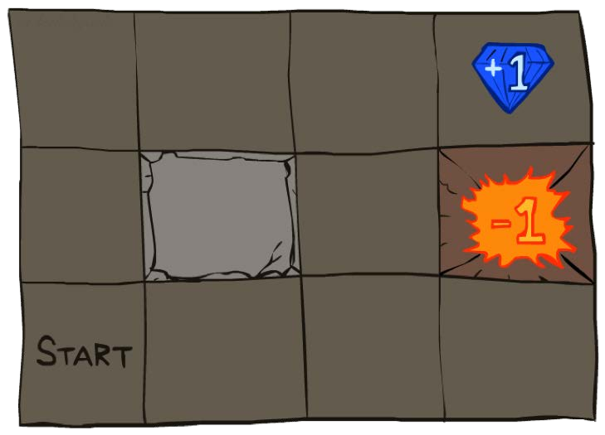
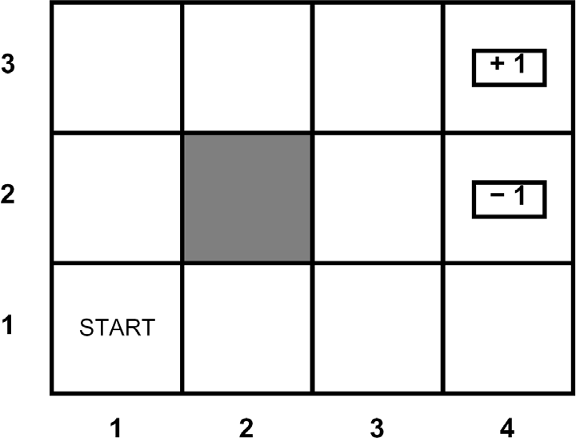




Example: Grid World
A maze-like problem
The agent lives in a grid
Walls block the agent’s path
Noisy movement: actions do not always go as planned
80% of the time, the action North takes the agent North (if there is no wall there)
10% of the time, North takes the agent West; 10% East
If there is a wall in the direction the agent would have been taken, the agent stays put
The agent receives rewards each time step
Small “living” reward each step (can be negative)
Big rewards come at the end (good or bad)
Goal: maximize sum of rewards

Slide 4
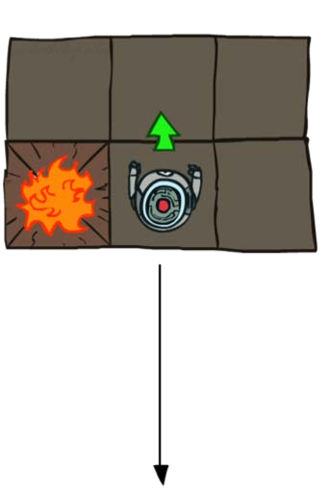
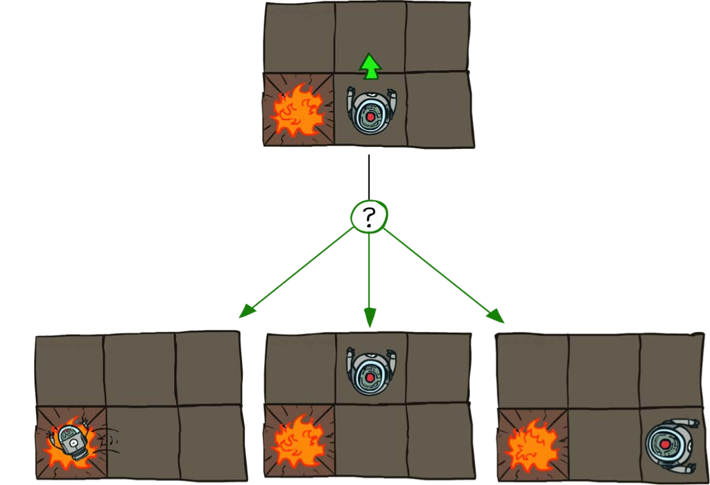
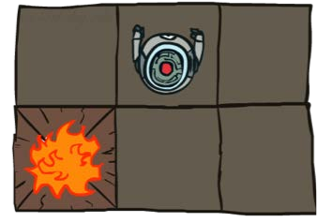
Grid World Actions
Deterministic Grid World Stochastic Grid World

Slide 5
Markov Decision Processes
An MDP is defined by:
A set of states s ∈ S
A set of actions a ∈ A
A transition function T(s, a, s’)
Probability that a from s leads to s’, i.e., P(s’| s, a)
Also called the model or the dynamics
A reward function R(s, a, s’)
Sometimes just R(s) or R(s’)
A start state
Maybe a terminal state
MDPs are non-deterministic search problems
One way to solve them is with expectimax search
We’ll have a new tool soon
[Demo – gridworld manual intro (L8D1)]

Slide 6
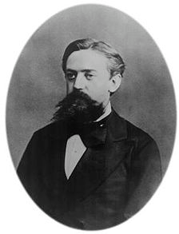

What is Markov about MDPs?
“Markov” generally means that given the present state, the future and the past are independent
For Markov decision processes, “Markov” means action outcomes depend only on the current state
Andrey Markov (1856-1922)
This is just like search, where the successor function could only depend on the current state (not the history)

Slide 7

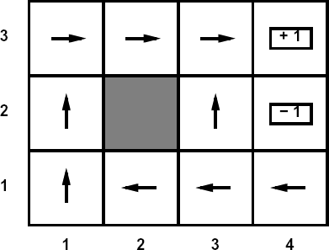
Policies
In deterministic single-agent search problems, we wanted an optimal plan, or sequence of actions, from start to a goal
For MDPs, we want an optimal policy π*: S → A
A policy π gives an action for each state
An optimal policy is one that maximizes expected utility if followed
An explicit policy defines a reflex agent
Expectimax didn’t compute entire policies
It computed the action for a single state only
Optimal policy when R(s, a, s’) = -0.03 for all non-terminals s

Slide 8
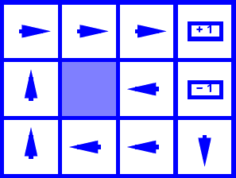
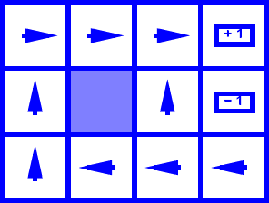
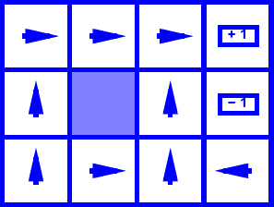
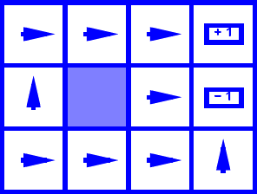
Optimal Policies
R(s) = -0.01
R(s) = -0.03
R(s) = -0.4
R(s) = -2.0

Slide 9
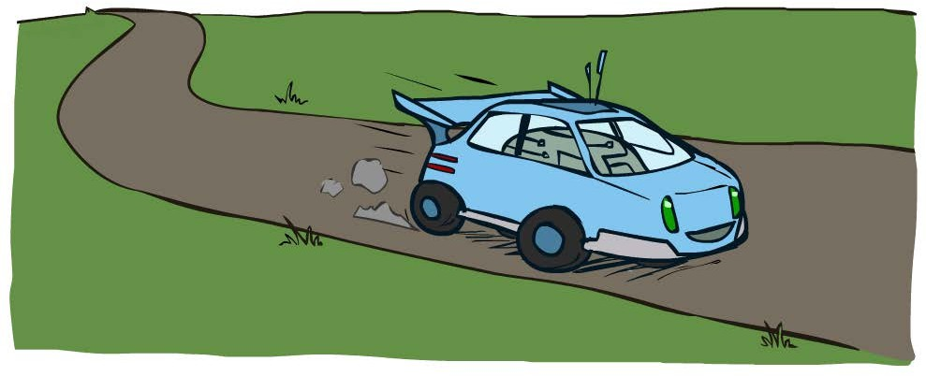
Example: Racing

Slide 10
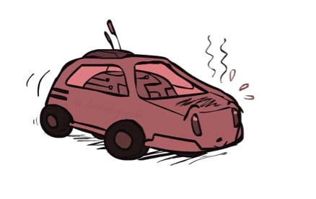
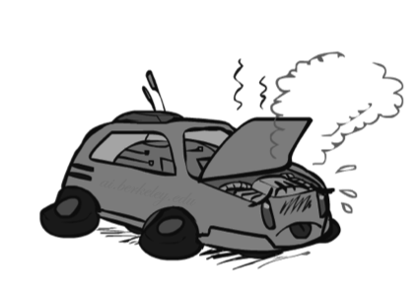
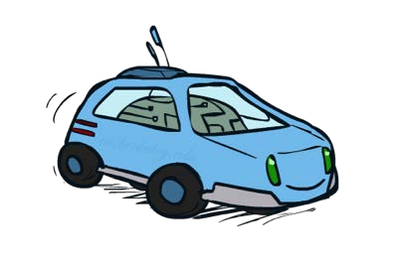
Example: Racing
A robot car wants to travel far, quickly
Three states: Cool, Warm, Overheated
Two actions: Slow, Fast
Going faster gets double reward
0.5
+1
1.0
Fast
Slow
-10
+1
0.5
Warm
Slow
Fast
0.5 +2
Cool
0.5
Overheated
+1
1.0
+2

Slide 11




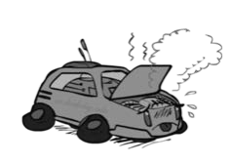
Racing Search Tree

Slide 12
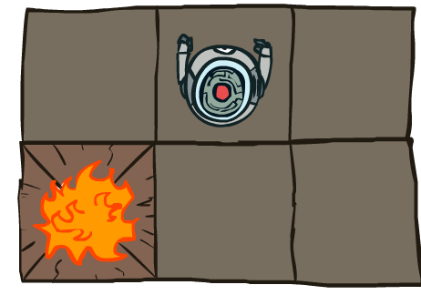
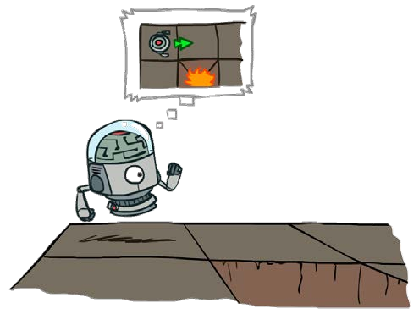

MDP Search Trees
Each MDP state projects an expectimax-like search tree
s
s is a state
a
(s, a) is a
q-state
s, a
(s,a,s’) called a transition T(s,a,s’) = P(s’|s,a) R(s,a,s’)
s,a,s’
s’

Slide 13
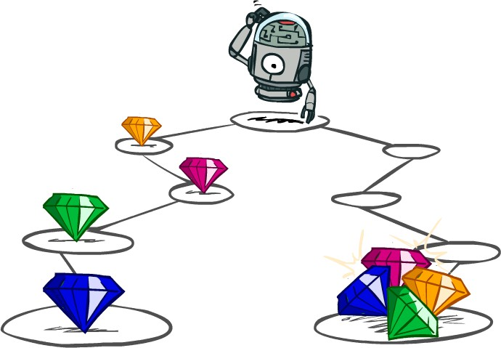
Utilities of Sequences

Slide 14
Utilities of Sequences
What preferences should an agent have over reward sequences?
More or less? [1, 2, 2] or [2, 3, 4]
Now or later? [0, 0, 1] or [1, 0, 0]

Slide 15






Discounting
It’s reasonable to maximize the sum of rewards
It’s also reasonable to prefer rewards now to rewards later
One solution: values of rewards decay exponentially
Worth Now
Worth Next Step
Worth In Two Steps

Slide 16









Discounting
How to discount?
Each time we descend a level, we multiply in the discount once
Why discount?
Sooner rewards probably do have higher utility than later rewards
Also helps our algorithms converge
Example: discount of 0.5
U([1,2,3]) = 1*1 + 0.5*2 + 0.25*3
U([1,2,3]) < U([3,2,1])

Slide 17
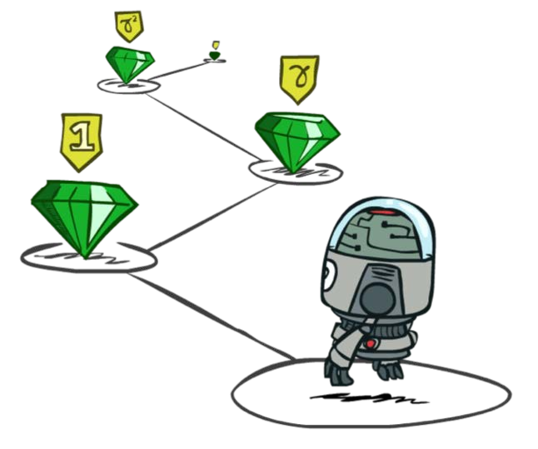


Stationary Preferences
Theorem: if we assume stationary preferences:
Then: there are only two ways to define utilities
Additive utility:
Discounted utility:

Slide 18
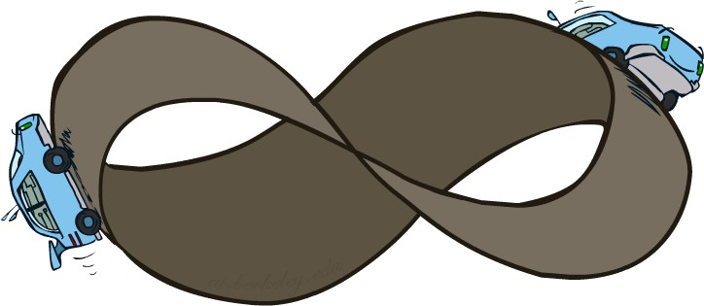
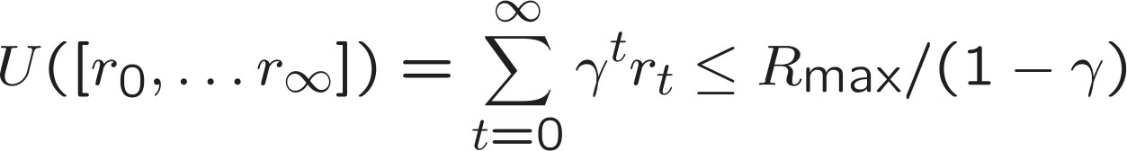
Infinite Utilities?!
Problem: What if the game lasts forever? Do we get infinite rewards?
Solutions:
Finite horizon: (similar to depth-limited search)
Terminate episodes after a fixed T steps (e.g. life)
Gives nonstationary policies (π depends on time left)
Discounting: use 0 < γ < 1
Smaller γ means smaller “horizon” – shorter term focus
Absorbing state: guarantee that for every policy, a terminal state will eventually be reached (like “overheated” for racing)

Slide 19

Solving MDPs

Slide 20
Recap: Defining MDPs
Markov decision processes:
Set of states S
Start state s₀
Set of actions A
Transitions P(s’|s,a) (or T(s,a,s’))
Rewards R(s,a,s’) (and discount γ)
s
a s, a
s,a,s’
s’
MDP quantities so far:
Policy = Choice of action for each state
Utility = sum of (discounted) rewards

Slide 21
Optimal Quantities
The value (utility) of a state s:
V*(s) = expected utility starting in s and acting optimally
s
s is a
state
a
(s, a) is a
q-state
The value (utility) of a q-state (s,a):
Q*(s,a) = expected utility starting out having taken action a from state s and (thereafter) acting optimally
s, a
s,a,s’
(s,a,s’) is a
transition
s’
The optimal policy:
π*(s) = optimal action from state s
[Demo – gridworld values (L8D4)]

Slide 22
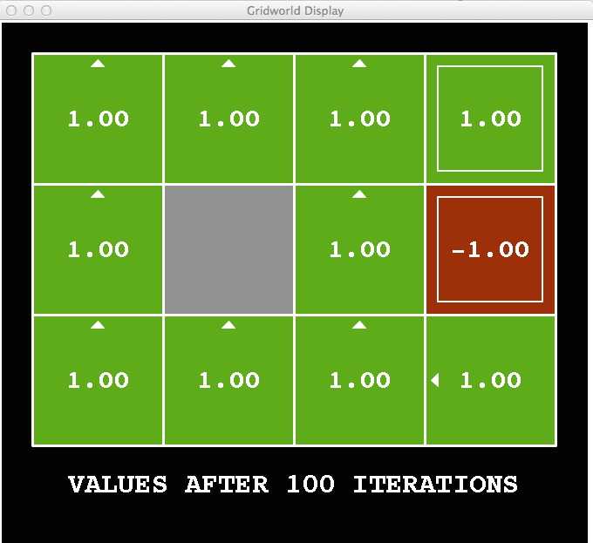
Snapshot of Demo – Gridworld V Values
Noise = 0 (Deterministic) Discount = 1
Living reward = 0

Slide 23
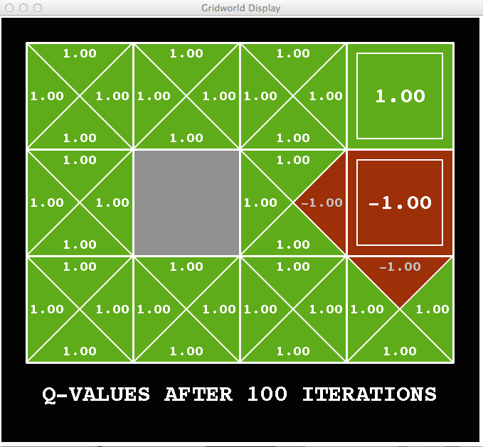
Snapshot of Demo – Gridworld Q Values
Noise = 0
Discount = 1
Living reward = 0

Slide 24
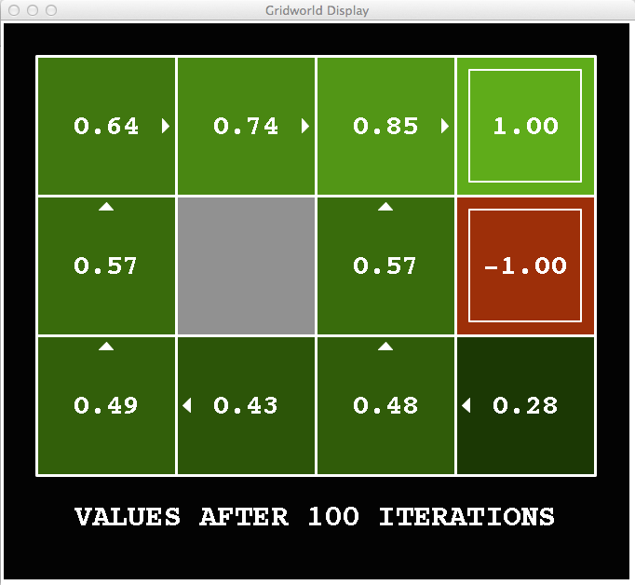
Snapshot of Demo – Gridworld V Values
Discount = 0.99
Living reward = 0.1

Slide 25
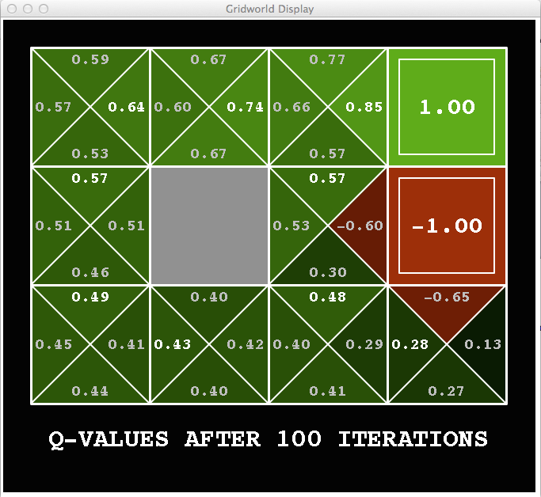
Snapshot of Demo – Gridworld Q Values
Discount = 0.99
Living reward = 0.1

Slide 26

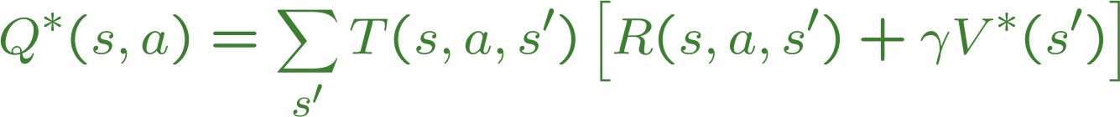
Values of States
Fundamental operation: compute the (expectimax) value of a state
Expected utility under optimal action
Average sum of (discounted) rewards
This is just what expectimax computed!
s
a s, a
Recursive definition of value:
s,a,s’
s’

Slide 27
Racing Search Tree

Slide 28






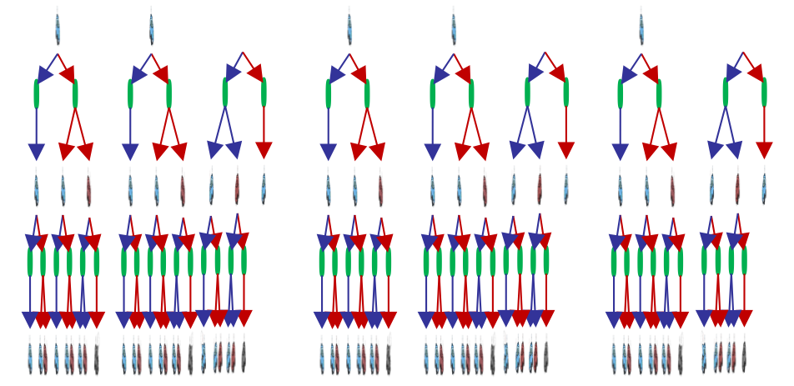


Racing Search Tree

Slide 29
Racing Search Tree
We’re doing way too much work with expectimax!
Problem: States are repeated
Idea: Only compute needed quantities once
Problem: Tree goes on forever
Idea: Do a depth-limited computation, but with increasing depths until change is small
Note: deep parts of the tree eventually don’t matter if γ < 1

Slide 30
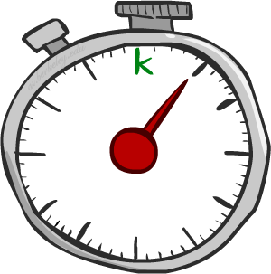






Time-Limited Values
Key idea: time-limited values
Define V_{k}(s) to be the optimal value of s if the game ends in k more time steps
Equivalently, it’s what a depth-k expectimax would give from s
[Demo – time-limited values (L8D6)]

Slide 31
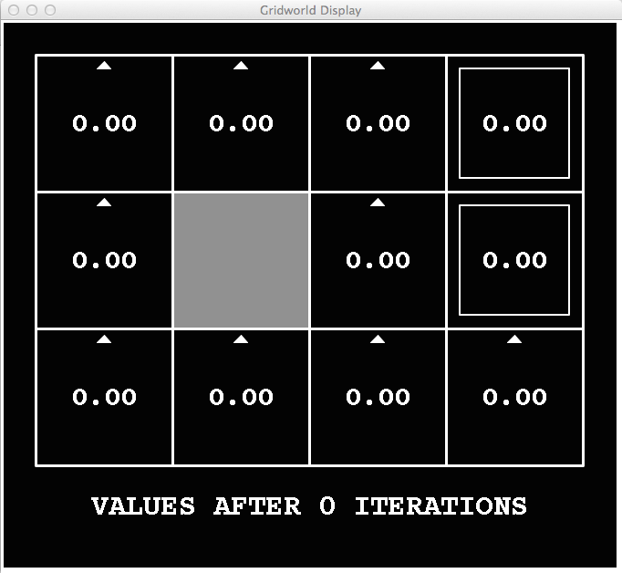
k=0
Noise = 0.2
Discount = 0.9 Living reward = 0

Slide 32
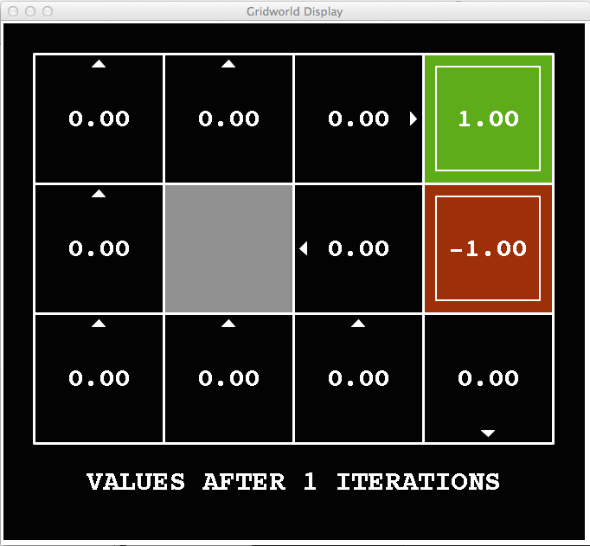
k=1
Noise = 0.2
Discount = 0.9 Living reward = 0

Slide 33
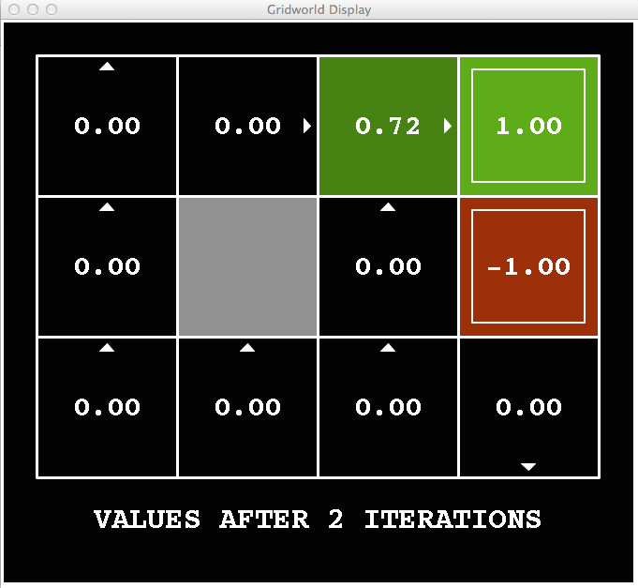
k=2
Noise = 0.2
Discount = 0.9 Living reward = 0

Slide 34
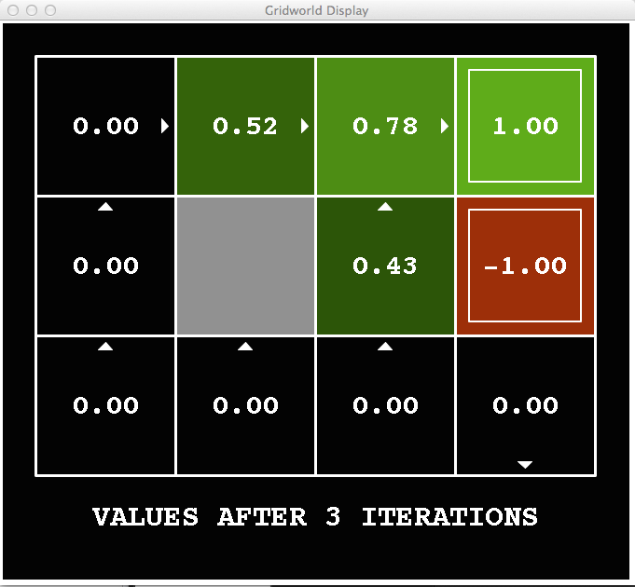
k=3
Noise = 0.2
Discount = 0.9 Living reward = 0

Slide 35
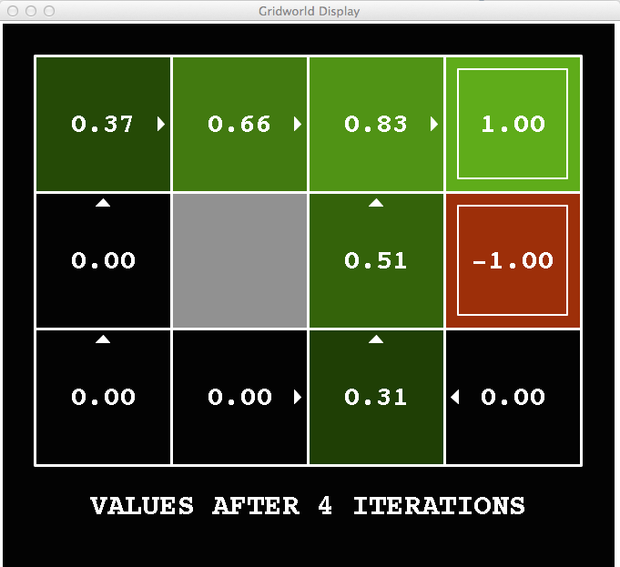
k=4
Noise = 0.2
Discount = 0.9 Living reward = 0

Slide 36
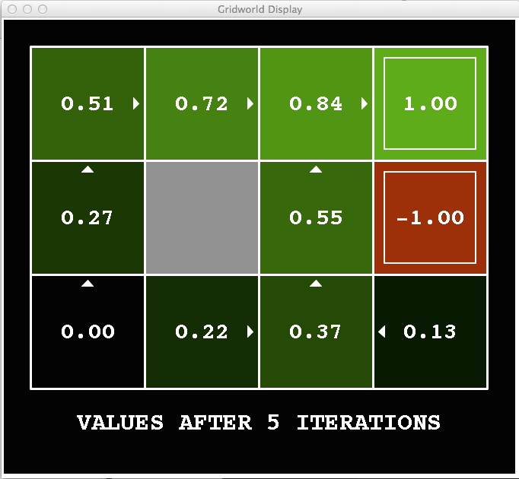
k=5
Noise = 0.2
Discount = 0.9 Living reward = 0

Slide 37
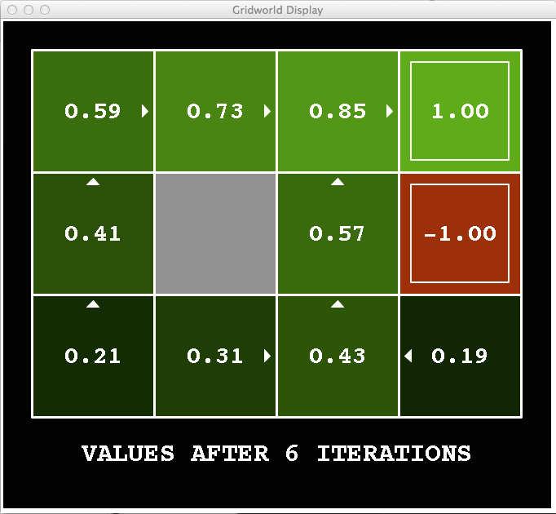
k=6
Noise = 0.2
Discount = 0.9 Living reward = 0

Slide 38
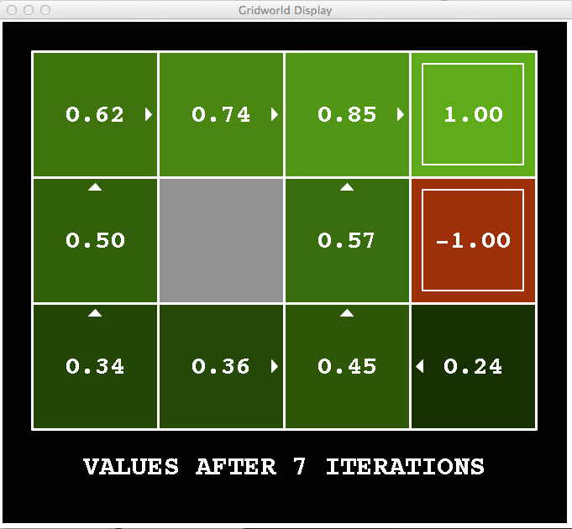
k=7
Noise = 0.2
Discount = 0.9 Living reward = 0

Slide 39
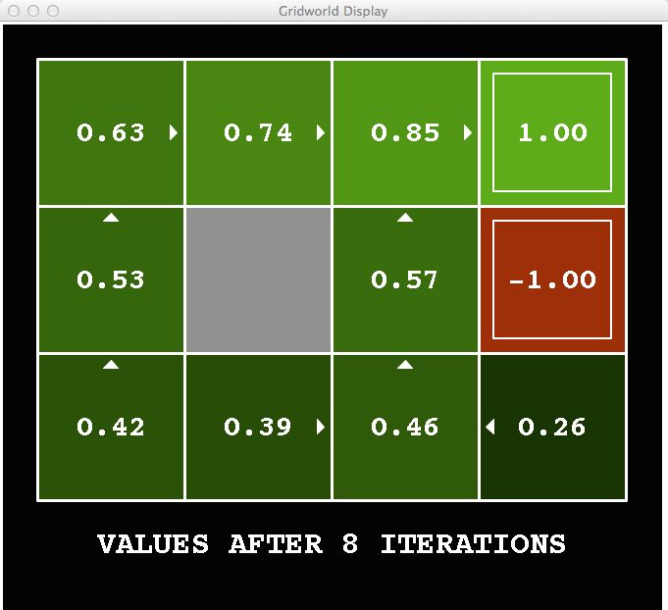
k=8
Noise = 0.2
Discount = 0.9 Living reward = 0

Slide 40
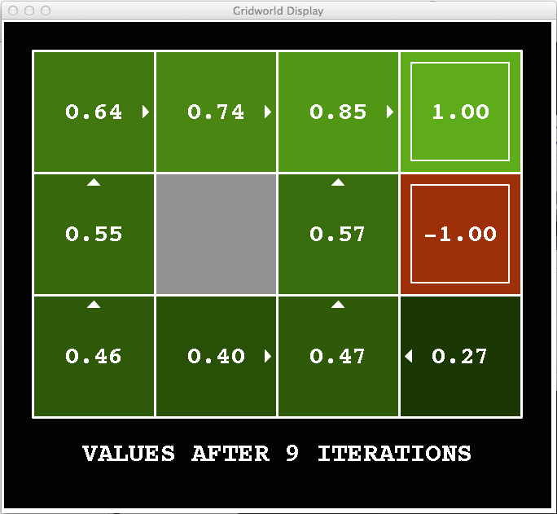
k=9
Noise = 0.2
Discount = 0.9 Living reward = 0

Slide 41
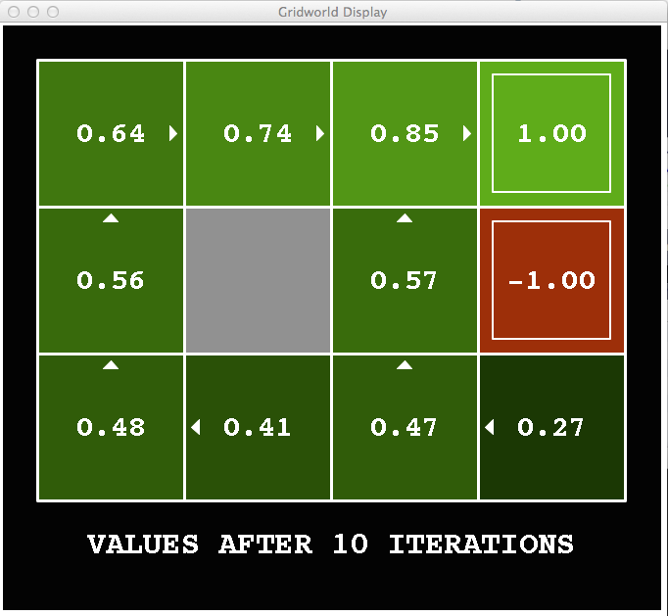
k=10
Noise = 0.2
Discount = 0.9 Living reward = 0

Slide 42

k=11
Noise = 0.2
Discount = 0.9 Living reward = 0

Slide 43

k=12
Noise = 0.2
Discount = 0.9 Living reward = 0

Slide 44

k=100
Noise = 0.2
Discount = 0.9 Living reward = 0

Slide 45






Computing Time-Limited Values

Slide 46

Value Iteration

Slide 47

Value Iteration
Start with V₀(s) = 0: no time steps left means an expected reward sum of zero
Given vector of V_{k}(s) values, do one ply of expectimax from each state:
V_{k+1}(s)
a s, a
Repeat until convergence
s,a,s’
V_{k}(s’)
Complexity of each iteration: O(S²A)
Theorem: will converge to unique optimal values
Basic idea: approximations get refined towards optimal values
Policy may converge long before values do

Slide 48



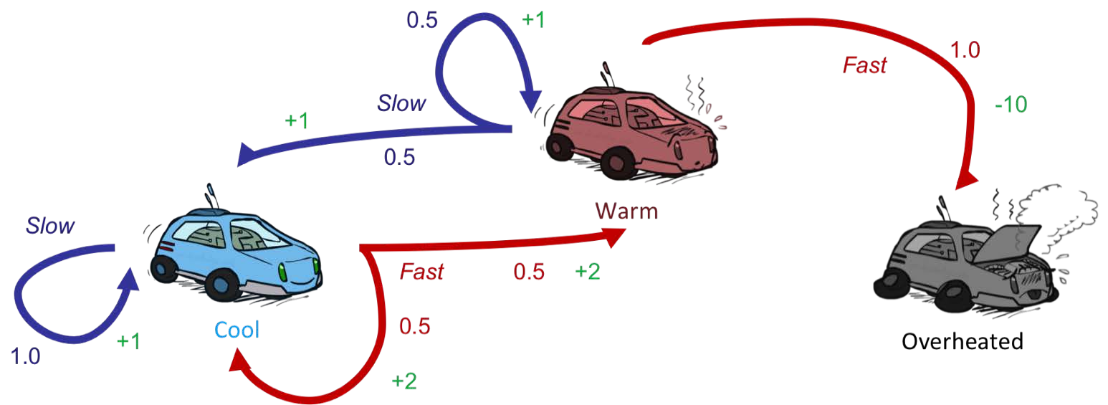



Example: Value Iteration
S: 1
F: .5*2+.5*2=2
Assume no discount!
0
0
0

Slide 49
Example: Value Iteration
S: .5*1+.5*1=1 F: -10
2
Assume no discount!
0
0
0

Slide 50
Example: Value Iteration
2
1
0
Assume no discount!
0
0
0

Slide 51
Example: Value Iteration
S: 1+2=3 F:
.5*(2+2)+.5*(2+1)=3.5
2 1
0
Assume no discount!
0
0
0

Slide 52
Example: Value Iteration
3.5
2.5
0
2
1
0
Assume no discount!
0
0
0

Slide 53


Convergence*
How do we know the V_{k} vectors are going to converge?
Case 1: If the tree has maximum depth M, then V_{M} holds the actual untruncated values
Case 2: If the discount is less than 1
Sketch: For any state V_{k} and V_{k+1} can be viewed as depth k+1 expectimax results in nearly identical search trees
The difference is that on the bottom layer, V_{k+1} has actual rewards while V_{k} has zeros
That last layer is at best all R_{MAX}
It is at worst R_{MIN}
But everything is discounted by γ^{k} that far out
So V_{k} and V_{k+1} are at most γ^{k} max|R| different
So as k increases, the values converge

